Slide 1
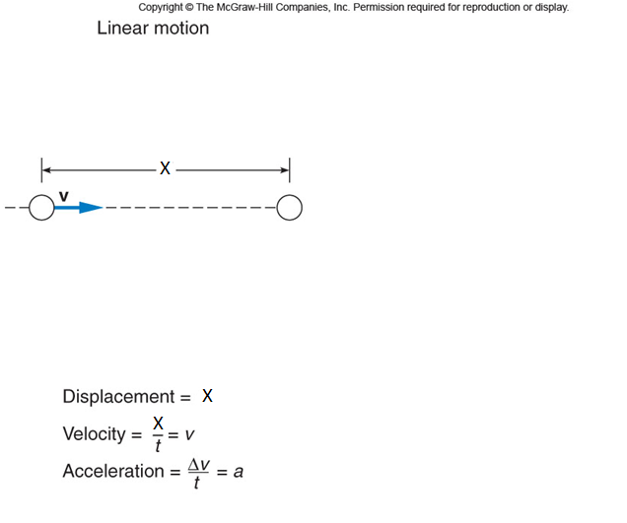
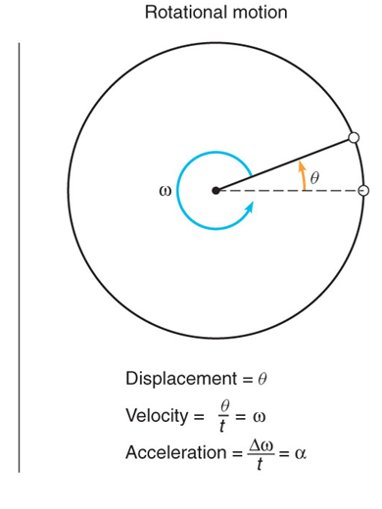
Rotational Motion

Slide 2

The angle θ
In radian measure, the angle θ is defined to be the arc length s divided by the radius r.

Slide 3

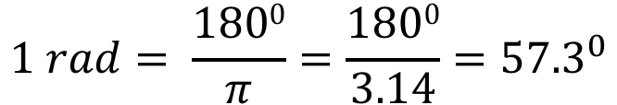
Conversion between degree and radian
π rad = 180⁰

Slide 4
Example Problems
Earth rotates once every day. What is the angular velocity of the rotation of earth?
What is the angular velocity of the minute hand of a mechanical clock?

Slide 5
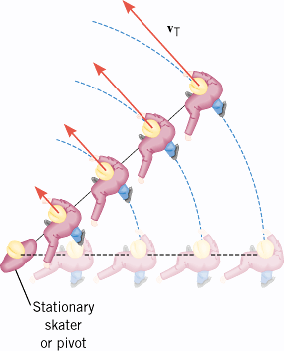
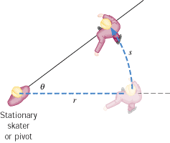
Angular Variables and Tangential/Linear
Variables
In the ice-skating stunt known as “crack-the-whip,” a number of skaters attempt to maintain a straight line as they skate around one person (the pivot) who remains in place.

Slide 6
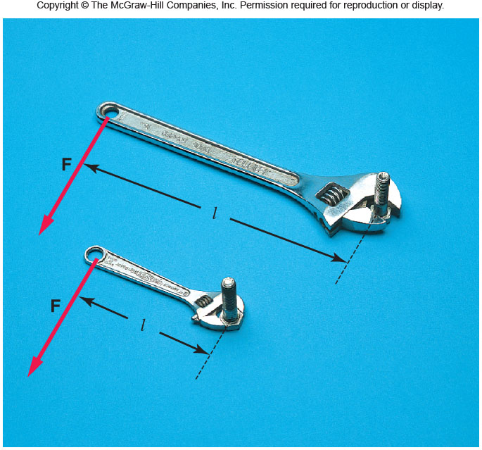
Torque, τ
Torque depends on the applied force and lever-arm.
Torque = Force x lever-arm
Torque is a vector. It comes in clockwise and counter-clock wise directions. Unit of torque = N•m
P: A force of 40 N is applied at the end of a wrench handle of length 20 cm in a direction perpendicular to the handle as shown above. What is the torque applied to the nut?

Slide 7
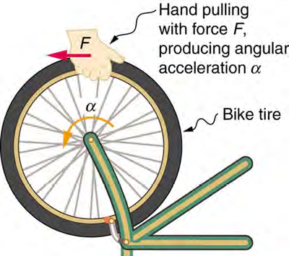
Newton’s 2nd law and
Rotational Inertia

Slide 8

NEWTON’S SECOND LAW FOR A RIGID BODY ROTATING ABOUT A FIXED AXIS

Slide 9

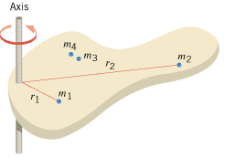
Moment of Inertia of point masses
Moment of inertia (or Rotational inertia) is a scalar.
SI unit for I: kg.m²

Slide 10
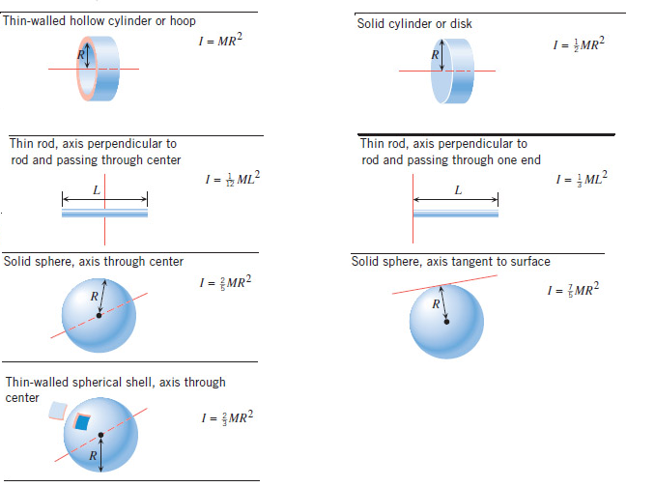
Moment of Inertia, I for Extended regular- shaped objects

Slide 11
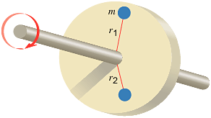
ROTATIONAL KINETIC ENERGY

Slide 12
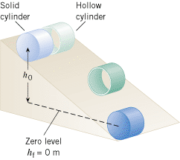
Demo on Rolling Cylinders

Slide 13
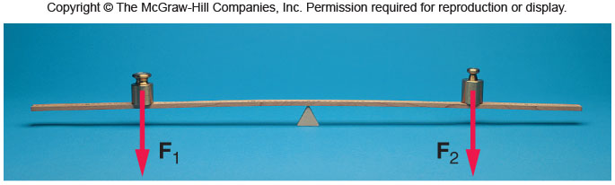
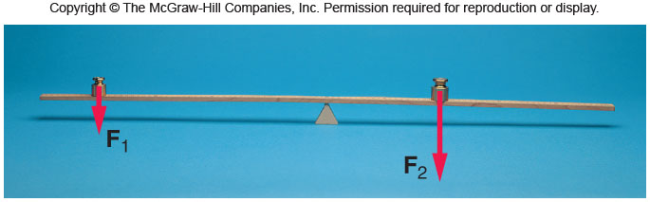
Application of Torque: Weighing
P. A child of mass 20 kg is located 2.5 m from the fulcrum or pivot point of a seesaw. Where must a child of mass 30 kg sit on the seesaw in order to provide balance?

Slide 14
Angular Momentum
The angular momentum L of a body rotating about a fixed axis is the product of the body's moment of inertia I and its angular velocity ω with respect to that axis:
Angular momentum is a vector.
SI Unit of Angular Momentum: kg · m²/s.

Slide 15
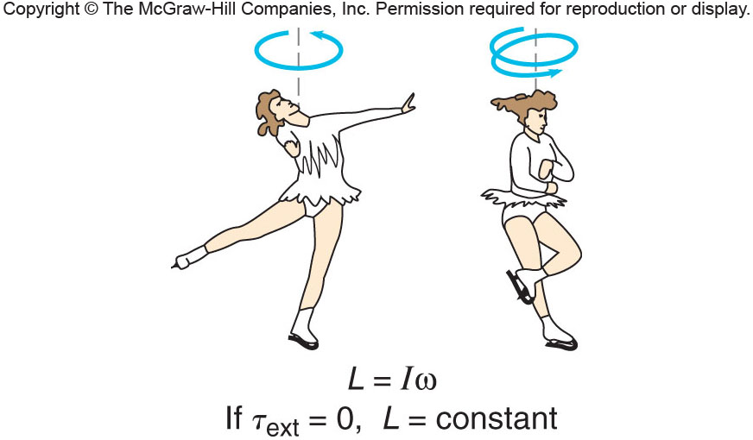
Conservation of Angular Momentum

Slide 16
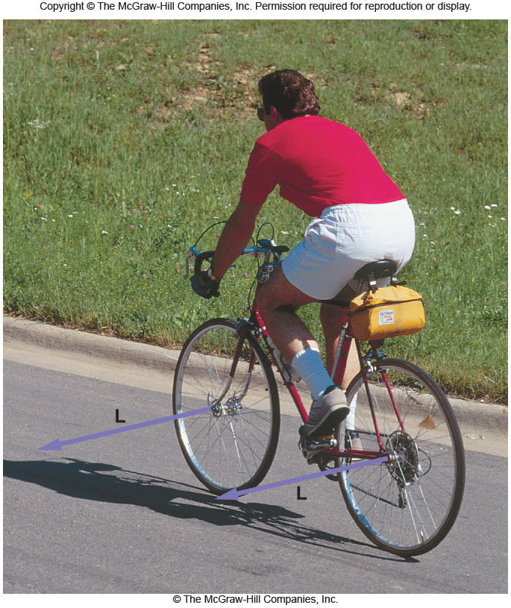
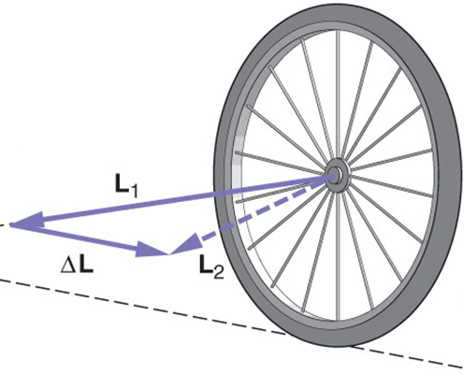
Angular momentum and Bicycles
Explain the role of angular momentum in riding a bicycle?

Slide 17
Equations Sheet
 | MOTION
 | Linear | Rotational
Time interval | t | t
Displacement | d; (d = rθ) | θ
Velocity | v = d/t; (v = rω) | ω = θ/t
Acceleration | a = Δv/t; (a = rα) | α = Δω/t
Kinematic equations | v = v₀ + at | ω = ω₀ + αt
 | v² = v₀² + 2ad | ω² = ω₀² + 2αθ
 | d = v₀t + ½ at² | θ = ω₀t + ½ αt²
 | d = ½(v + v₀)t | θ = ½(ω + ω₀)t
To create | force = F | torque =
Inertia | Mass =m | Rotational inertia = I = Σm_{i}r_{i}²
Newton’s 2nd Law | F_{net} = ma | τ_{net} = Iα
Momentum | p = m·V | L = I·ω
Conservation of momentum | Σm_{i}v_{i} = Σm_{f}v_{f} | ΣI_{i}ω_{i} = ΣI_{f}ω_{f}
Kinetic Energy | Translational Kinetic Energy = TKE = ½ mv² | Rotational Kinetic Energy = RKE = ½ Iω²
Work | W=F·d | W=τ·θ

Slide 18
Problem
A woman stands at the center of a platform. The woman and the platform rotate with an angular speed of 5.00 rad/s. Friction is negligible. Her arms are outstretched, and she is holding a dumbbell in each hand. In this position the total moment of inertia of the rotating system (platform, woman, and dumbbells) is 5.40 kg·m². By pulling in her arms, she reduces the moment of inertia to 3.80 kg·m². Find her new angular speed.

